Slide 1

Mobile Development
Flutter: Basic Widgets
Aug 24, 2021
Ariel Cosep,
Application System Engineer
WeServ Systems International, Inc.

Slide 2
Objective
To learn basic knowledge about mobile development using Flutter

Slide 3
Recap
What is Flutter?
Key features of Flutter.
Supported Platforms
What is widget?
What are the types of widgets?
And other more.

Slide 4
Basic Widgets
MaterialApp
Scaffold
AppBar
Drawer
BottomSheet
BottomNavigationBar
TabBar
Text
TextField
Buttons
Image
Icon

Slide 5
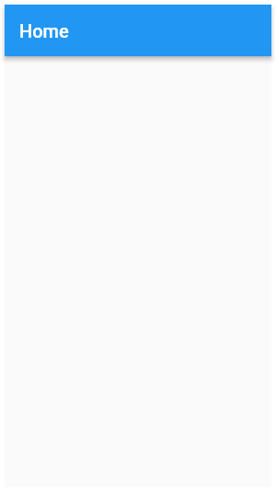
MaterialApp
MaterialApp(
home: Scaffold(
appBar: AppBar(
title: const Text('Home'),
),
),
)

Slide 6
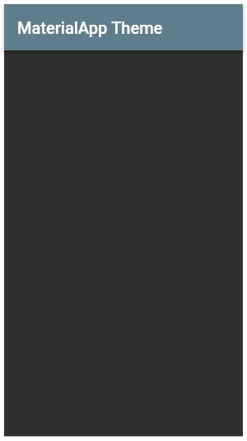
MaterialApp
MaterialApp(
theme: ThemeData(
fontFamily: 'Raleway',
brightness: Brightness.dark, primaryColor: Colors.blueGrey
),
home: Scaffold(
appBar: AppBar(
title: const Text('MaterialApp Theme'),
),
),
)

Slide 7
MaterialApp
MaterialApp(
theme: ThemeData(
brightness: Brightness.light,
primarySwatch: Colors.orange,
),
darkTheme: ThemeData(
brightness: Brightness.dark,
primarySwatch: Colors.orange
),
home: Scaffold(
appBar: AppBar(
title: const Text('MaterialApp Theme'),
),
),
)

Slide 8
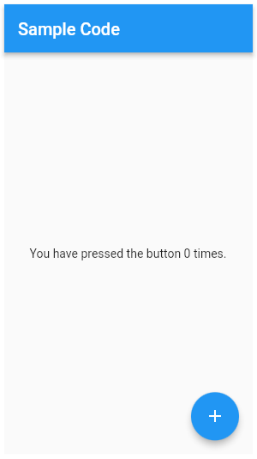
Scaffold
MaterialApp(
home: Scaffold(
appBar: AppBar(
title: const Text('Sample Code'),
),
body: Center(
child: Text('You have pressed the button $_count times.')
),
floatingActionButton: FloatingActionButton(
onPressed: () => setState(() => _count++),
tooltip: 'Increment Counter',
child: const Icon(Icons.add),
),
),
)

Slide 9
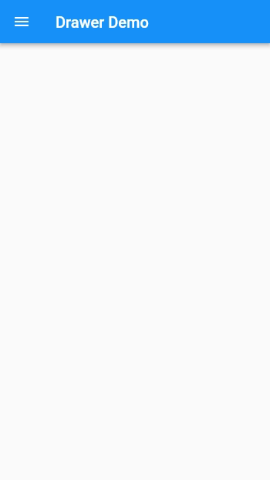
Scaffold

Slide 10
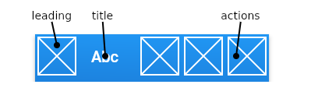
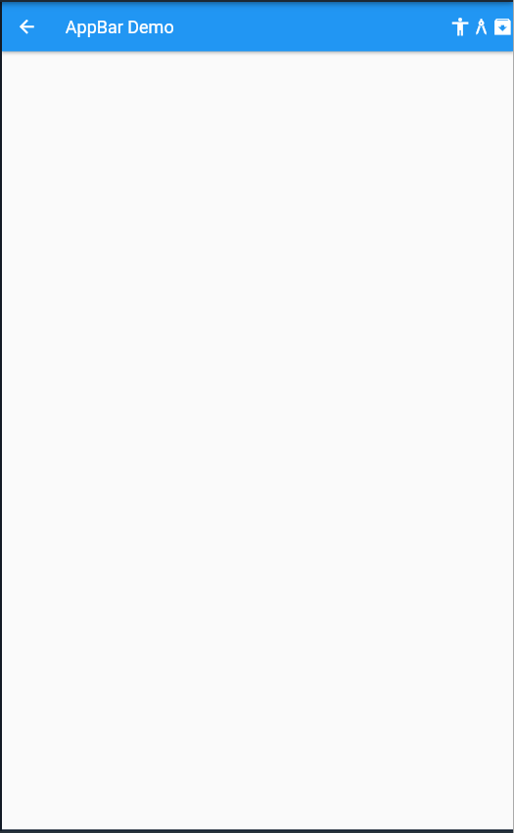
AppBar
MaterialApp(
home: Scaffold(
appBar: AppBar(
leading: const Icon(Icons.arrow_back),
title: const Text('AppBar Demo'),
actions: <Widget>[
const Icon(Icons.accessibility),
const Icon(Icons.architecture_rounded),
const Icon(Icons.archive_sharp),
],
),
),
)

Slide 11
Drawer
MaterialApp(
home: Scaffold(
appBar: AppBar(
title: const Text(‘Drawer Demo'),
),
drawer: Drawer(
child: ListView(
children: const <Widget>[
messages,
profile,
settings,
]
),
),
),
)

Slide 12
BottomSheet
Scaffold(
appBar: AppBar(
title: const Text('Flutter Demo Home Demo'),
),
floatingActionButton: FloatingActionButton(
child: Icon(Icons.add),
onPressed: (){
showModalBottomSheet(
context: context,
builder: (context){
return Container(
height: 150,
color: Colors.green,
);
}
);
},
),
)

Slide 13
BottomNavigationBar
Scaffold(
appBar: AppBar(
title: const Text(‘BottomNavigationBar Demo'),
),
body: Center(
child: _widgetOptions.elementAt(_selectedIndex),
),
bottomNavigationBar: BottomNavigationBar(
items: const <BottomNavigationBarItem>[
BottomNavigationBarItem(
icon: Icon(Icons.home),
label: 'Home',
),
etc…
],
currentIndex: _selectedIndex,
selectedItemColor: Colors.amber[800],
onTap: (index){setState((){_selectecIndex = index});},
)
)

Slide 14
TabBar
DefaultTabController(
initialIndex: 1,
length: 3,
child: Scaffold(
appBar: AppBar(
title: const Text('TabBar Widget'),
bottom: const TabBar(
tabs: <Widget>[
Tab(
icon: Icon(Icons.cloud_outlined),
),
beachTab(),
brightnessTab(),
],
),
),
body: const TabBarView(
children: <Widget>[
cloudText(),
rainyText(),
sunnyText(),
],
),
),
)

Slide 15
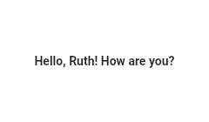
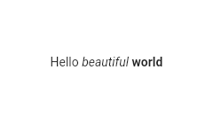
Text
Text(
'Hello, $_name! How are you?',
textAlign: TextAlign.center,
overflow: TextOverflow.ellipsis,
style: TextStyle(fontWeight: FontWeight.bold),
)
Text.rich(
TextSpan(
text: 'Hello',
children: <TextSpan>[
TextSpan(text: ' beautiful ', style: TextStyle(fontStyle: FontStyle.italic)), TextSpan(text: 'world', style: TextStyle(fontWeight: FontWeight.bold)),
],
),
)

Slide 16
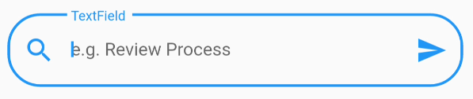
TextField
TextField(
controller: controller,
keyboardType: TextInputType.text,
onSubmitted: (val){
},
decoration: InputDecoration(
labelText: 'TextField',
hintText: 'e.g. Review Process',
prefixIcon: Icon(Icons.search),
border: OutlineInputBorder(
borderRadius: BorderRadius.all(Radius.circular(25.0)),
),
),
)

Slide 17
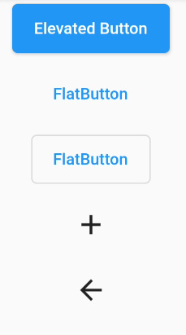
Buttons
ElevatedButton(onPressed: (){}, child: Text('Elevated Button’)),
TextButton(onPressed: (){}, child: Text('FlatButton’)),
OutlinedButton(onPressed: (){},child: Text('FlatButton'),),
IconButton(icon: Icon(Icons.add),onPressed: (){},),
BackButton()

Slide 18
Buttons: DropDownButton
DropdownButton<String>(
value: dropdownValue,
onChanged: (String newValue) {
setState(() {
dropdownValue = newValue;
});
},
items: <String>['One', 'Two', 'Three', 'Four']
.map<DropdownMenuItem<String>>((String value) {
return DropdownMenuItem<String>(
value: value,
child: Text(value),
);
}).toList(),
),

Slide 19
Buttons: PopUpMenuButton
PopupMenuButton<number>(
onSelected: (number result) { setState(() { _selection = result; }); },
itemBuilder: (BuildContext context) => <PopupMenuEntry<number>>[
const PopupMenuItem<number>(
value: number.one,
child: Text('One'),
),
const PopupMenuItem<number>(
value: number.two,
child: Text('Two'),
),
const PopupMenuItem<number>(
value: number.three,
child: Text('Three'),
),
],
)

Slide 20
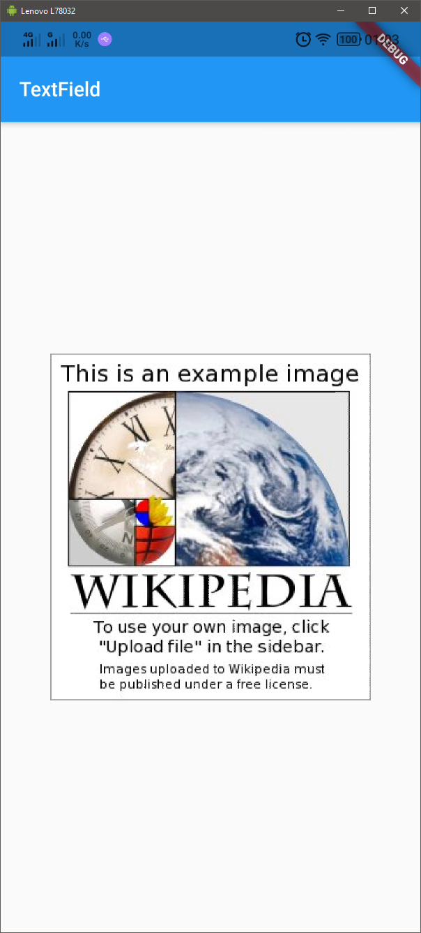
Image
Image(
image: NetworkImage(‘https://upload.wikimedia.org/wikipedia/en/a/a9/Example.jpg’),
),

Slide 21
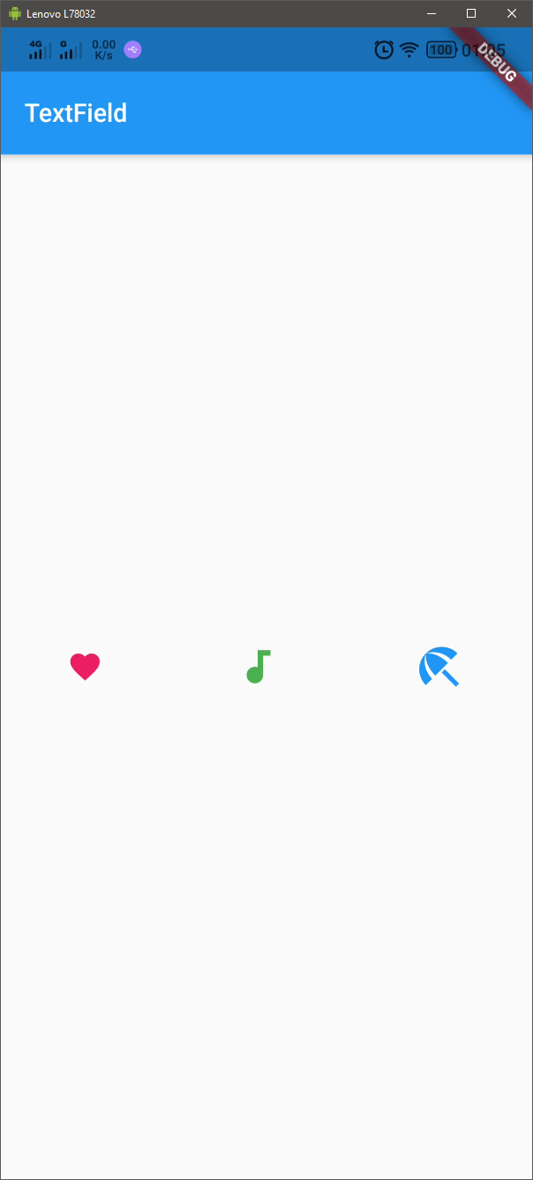
Icon
Row(
mainAxisAlignment: MainAxisAlignment.spaceAround,
children: const <Widget>[
Icon(
Icons.favorite,
color: Colors.pink,
size: 24.0,
),
Icon(
Icons.audiotrack,
color: Colors.green,
size: 30.0,
),
Icon(
Icons.beach_access,
color: Colors.blue,
size: 36.0,
),
],
)

